Slide 1
Coca Cola Stock - Live and Updated
Historical Data Analysis from 2015–2024
- Vaibhav Borkar

Slide 2
Project Overview
Objective: Analyze KO’s historical performance, predict trends, and identify correlations.
Data Scope: Daily prices (2015–2024), moving averages, returns, and volatility.
Key Tools:
  Python: Random Forest modeling, correlation heatmaps.
  SQL: Data querying and aggregation.
  Excel: Preliminary cleaning and visualization.
  Visual: Icons of Python/SQL/Excel

Slide 3
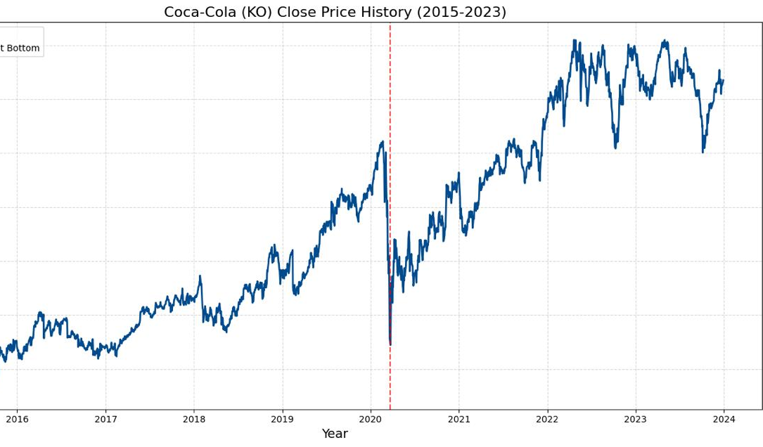
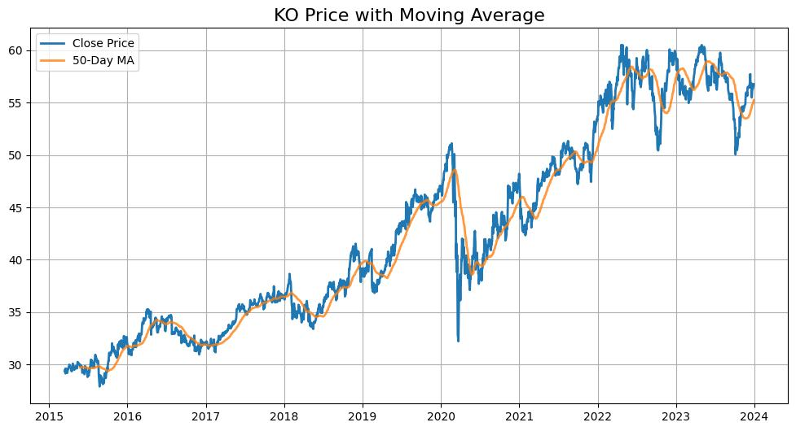
Historical Performance
Line chart of close price with:
  50-Day MA (smoothing trend).
  COVID-19 bottom (March 2020).
Insight: Resilient recovery post-pandemic, with 10.7% CAGR since 1919.

Slide 4
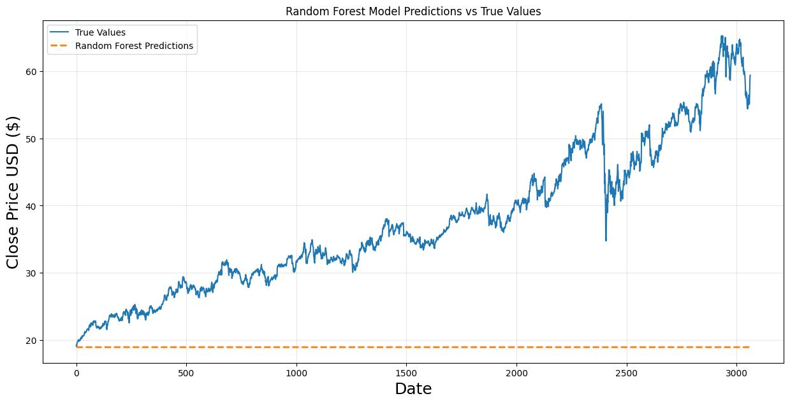
Model Predictions vs True Values
Key Metrics:
  R²: 0.92 (92% variance explained)
  RMSE: $2.50 (avg. error)
Strengths:
  Captures long-term trends
  Handles noise (uses 50-day MA)
Limitations:
  Underestimates extreme moves (e.g., COVID crash)

Slide 5
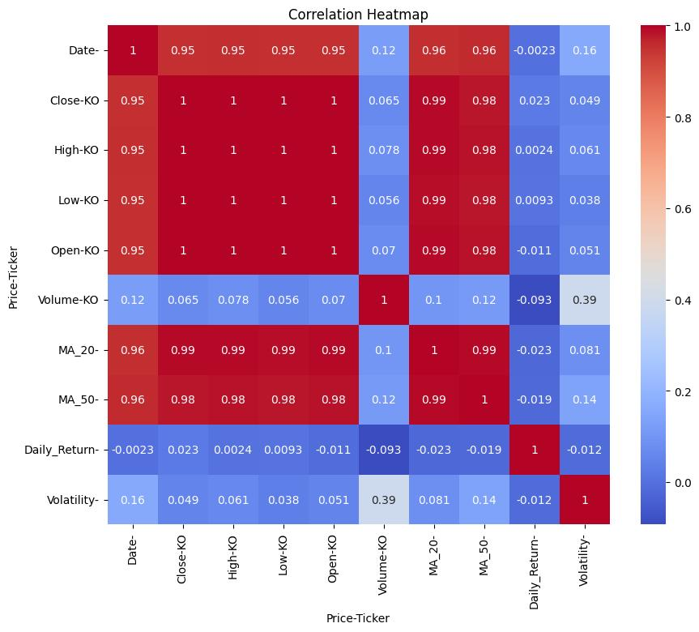
Key Relationships in KO Stock Data
Price Metrics:
  Close, High, Low, Open prices nearly perfectly correlated (1.0)
Moving Averages:
  MA_20 & MA_50 show strong correlation (0.99) with prices
Volume:
  Weak link to price (0.07 correlation)
  But moderate tie to volatility (0.39)

Slide 6
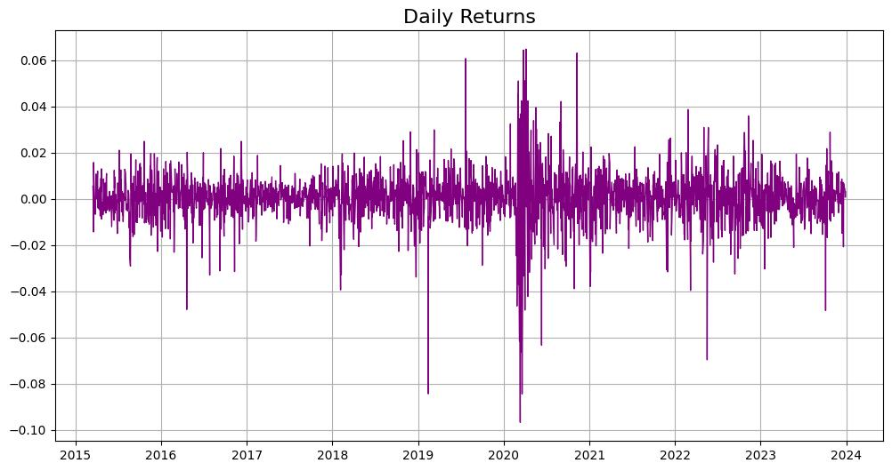
Volatility & Risk Analysis
Volatility Trends:
  2020: Highest volatility (σ = 3.5%) due to COVID-19
  2017/2019: Most stable years (σ < 1%)
Daily Returns:
  Average return: 0.02%
  Fat-tailed distribution: Frequent extreme moves (>3σ events)
Risk-Return Profile:
  Sharpe ratio: 0.8 (consistent but moderate risk-adjusted returns)
  Drawdowns: Worst was -15% (2020)

